Slide 1

Business Analytics: Methods, Models, and Decisions
Third Edition
Chapter 7
Statistical Inference
Copyright © 2020, 2016, 2013 Pearson Education, Inc. All Rights Reserved
Notes:
If this PowerPoint presentation contains mathematical equations, you may need to check that your computer has the following installed:
1) MathType Plugin
2) Math Player (free versions available)
3) NVDA Reader (free versions available)

Slide 2
Statistical Inference
Statistical inference focuses on drawing conclusions about populations from samples.
Statistical inference includes estimation of population parameters and hypothesis testing, which involves drawing conclusions about the value of the parameters of one or more populations.

Slide 3
Hypothesis Testing
Hypothesis testing involves drawing inferences about two contrasting propositions (each called a hypothesis) relating to the value of one or more population parameters.
Null hypothesis: describes an existing theory
Alternative hypothesis: the complement of
Using sample data, we either:
reject
and conclude the sample data provides sufficient
evidence to support
or
fail to reject
and conclude the sample data does not support

Slide 4
Example 7.1: A Legal Analogy for Hypothesis Testing
In the U.S. legal system, a defendant is innocent until proven guilty.
Innocent
Guilty
If evidence (sample data) strongly indicates the
defendant is guilty, then we reject
Note that we have not proven guilt or innocence!

Slide 5
Hypothesis Testing Procedure
Steps in conducting a hypothesis test:
Identify the population parameter and formulate the hypotheses to test.
Select a level of significance (the risk of drawing an incorrect conclusion).
Determine the decision rule on which to base a conclusion.
Collect data and calculate a test statistic.
Apply the decision rule and draw a conclusion.

Slide 6
One-Sample Hypothesis Tests
Three types of one sample tests:
It is not correct to formulate a null hypothesis using

Slide 7
Determining the Proper Form of Hypotheses
Hypothesis testing always assumes that
is true and
uses sample data to determine whether
is more likely
to be true.
Statistically, we cannot “prove” that
is true; we can only
fail to reject it.
Rejecting the null hypothesis provides strong evidence (in a statistical sense) that the null hypothesis is not true and that the alternative hypothesis is true.
Therefore, what we wish to provide evidence for statistically should be identified as the alternative hypothesis.

Slide 8
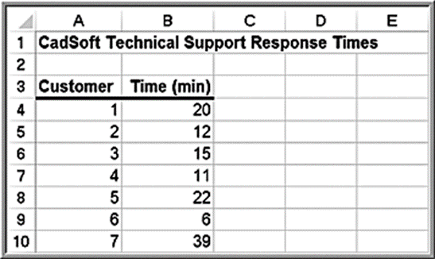
Example 7.2: Formulating a One-Sample Test of Hypothesis
CadSoft receives calls for technical support. In the past, the average response time has been at least 25 minutes. It believes the average response time can be reduced to less than 25 minutes.
If the new information system makes a difference, then, data should be able to confirm that the mean response time is
less than 25 minutes; this defines the alternative hypothesis,

Slide 9
Understanding Potential Errors in Hypothesis Testing
Hypothesis testing can result in one of four different outcomes:
is true and the test correctly fails to reject
is false and the test correctly rejects
is true and the test incorrectly rejects
(called Type I error)
is false and the test incorrectly fails to reject
(called Type II error)

Slide 10
Terminology
The probability of making a Type Ⅰ error
The value of
is called the confidence coefficient
The value of
can be controlled. Common values are 0.01, 0.05, or
0.10.
The probability of making a Type Ⅱ error
The value of
is called the power of the test
The value of
cannot be specified in advance and depends on the
value of the (unknown) population parameter.

Slide 11
Example 7.3: How β Depends on the True Population Mean
In the CadSoft example:
If the true mean is 15, then the sample mean will most likely be
less than 25, leading us to reject
If the true mean is 24, then the sample mean may or may not be
less than 25, and we would have a higher chance of failing to
reject
The further away the true mean is from the hypothesized value, the smaller the value of β.
Generally, as α decreases, β increases.

Slide 12
Improving the Power of the Test
We would like the power of the test to be high (equivalently, we would like the probability of a Type Ⅱ error to be low) to allow us to make a valid conclusion.
The power of the test is sensitive to the sample size; small sample sizes generally result in a low value of 1 − β.
The power of the test can be increased by taking larger samples, which enable us to detect small differences between the sample statistics and population parameters with more accuracy.
If you choose a small level of significance, you should try to compensate by having a large sample size.

Slide 13
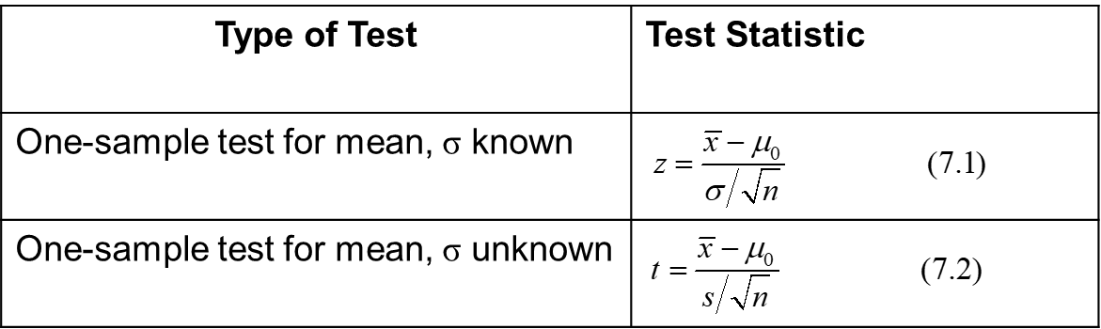
Selecting the Test Statistic
The decision to reject or fail to reject a null hypothesis is based on computing a test statistic from the sample data.
The test statistic used depends on the type of hypothesis test.
Test statistics for one-sample hypothesis tests for means:

Slide 14
Example 7.4: Computing the Test Statistic
In the CadSoft example, sample data for 44 customers revealed a mean response time of 21.91 minutes and a sample standard deviation of 19.49 minutes.
t = −1.05 indicates that the sample mean of 21.91 is 1.05 standard errors below the hypothesized mean of 25 minutes.

Slide 15
Drawing a Conclusion
The conclusion to reject or fail to reject
is based on
comparing the value of the test statistic to a “critical value” from the sampling distribution of the test statistic when the null hypothesis is true and the chosen level of significance, α.
The sampling distribution of the test statistic is usually the normal distribution, t-distribution, or some other well-known distribution.
The critical value divides the sampling distribution into two parts, a rejection region and a non-rejection region. If the test statistic falls into the rejection region, we reject the null hypothesis; otherwise, we fail to reject it.

Slide 16
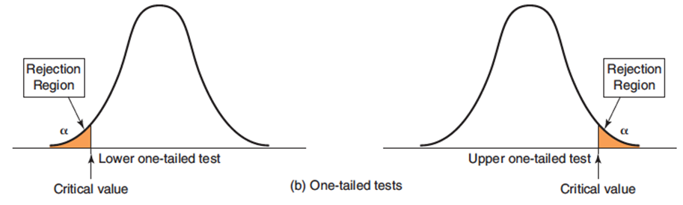
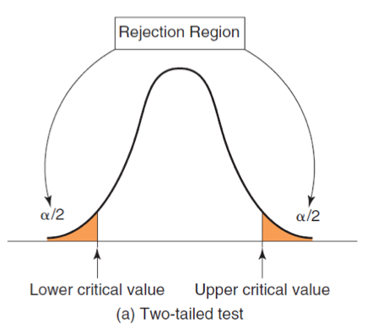
Rejection Regions
For a one-tailed test, if
is stated as <, the rejection region is in the
lower tail; if
is stated as >, the rejection region is in the upper tail (just
think of the inequality as an arrow pointing to the proper tail direction).

Slide 17
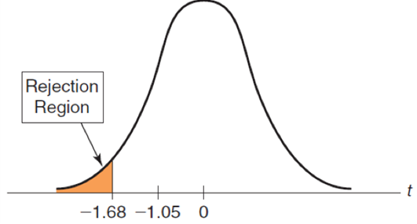
Example 7.5: Finding the Critical Value and Drawing a Conclusion
In the CadSoft example, use α = 0.05.
t = −1.05
Critical value
For a lower-tailed test, use −1.68
t = −1.05 does not fall in the rejection region.
Fail to reject
Even though the sample mean of 21.91 is well below 25, we have too much sampling error to conclude the that the true population mean is less than 25 minutes.

Slide 18
Two-Tailed Hypothesis Test for the Mean
For a two-tailed test using the t-distribution, use
the Excel function
to find the critical value,
Be careful when using
Use α and not
in this function.

Slide 19
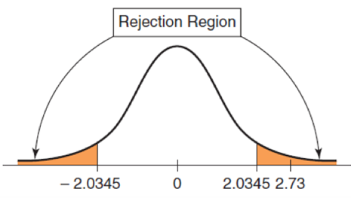
Example 7.6: Conducting a Two-Tailed Hypothesis Test for the Mean
Excel file Vacation Survey
Test whether the average age of respondents is equal to 35.
n = 34; sample mean = 38.676; sample standard deviation = 7.857.
Test statistic:
Critical value
Reject

Slide 20
p-Values
A p-value (observed significance level) is the probability of obtaining a test statistic value equal to or more extreme than that obtained from the sample data when the null hypothesis is true.
An alternative approach to Step 3 of a hypothesis test uses the p-value rather than the critical value:
Reject
if the p-value < α

Slide 21
Finding p-Values When σ is Known
For a lower one-tailed test, the p-value is the probability to the left of the test statistic t in the t-distribution, and is found using the Excel function:
For an upper one-tailed test, the p-value is the probability to the right of the test statistic t, and is found using the Excel function:
For a two-tailed test, the p-value is found using the Excel function:

Slide 22
Finding p-Values When σ is Unknown
For a lower one-tailed test, the p-value is the probability to the left of the test statistic t in the t-distribution, and is found using the Excel function:
For an upper one-tailed test, the p-value is the probability to the right of the test statistic t, and is found using the Excel function:
For a two-tailed test, the p-value is found using the Excel function:

Slide 23
Example 7.7: Using p-Values
In the CadSoft example, the p-value is the left tail area of the observed test statistic, t = −1.05.
p-value
Do not reject
because the
For the Vacation Survey two-tailed hypothesis test in Example 7.6, the p-value for this test is
p-value
Reject
because 0.010 < 0.05

Slide 24
One-Sample Tests for Proportions
Test statistic:
is the hypothesized value and
is the sample
proportion

Slide 25
Example 7.8: One-Sample Test for the Proportion (1 of 2)
CadSoft sampled 44 customers and asked them to rate the overall quality of a software package. Sample data
revealed that 35 respondents (a proportion of
thought the software was very good or excellent. In the past, this proportion has averaged about 75%. Is there sufficient evidence to conclude that this satisfaction measure has significantly exceeded 75% using a significance level of 0.05?

Slide 26
Example 7.8: One-Sample Test for the Proportion (2 of 2)
Hypotheses:
Test statistic:
Critical value
p-value
Do not reject

Slide 27
Confidence Intervals and Hypothesis Tests - Two-Tailed Tests
Suppose we construct a 95% confidence interval for the mean. If we wish to test the hypotheses
at a 5% level of significance, we simply check
whether the hypothesized value
falls within
the confidence interval. If it does not, then we
reject
if it does, then we cannot reject

Slide 28
Confidence Intervals and Hypothesis Tests - One-Tailed Tests
For a lower-tailed test, if the confidence interval falls entirely below the hypothesized value, we reject the null hypothesis.
For an upper-tailed test, if the confidence interval falls entirely above the hypothesized value, we also reject the null hypothesis.

Slide 29
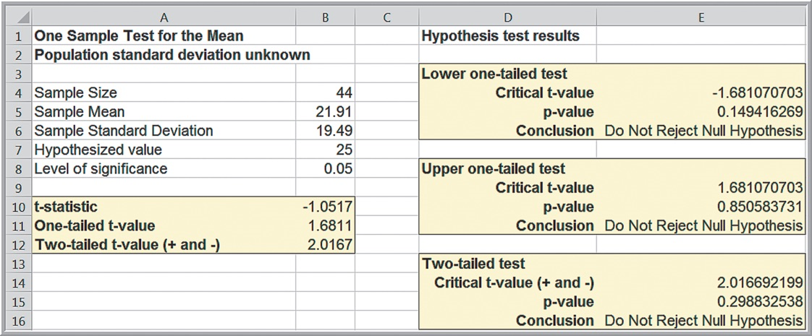
Excel Templates
The Excel file One Sample Hypothesis Tests provides template worksheets for conducting hypothesis tests for means and proportions. One example:

Slide 30
Two-Sample Hypothesis Tests (1 of 3)
Lower-tailed test
This test seeks evidence that the difference between population parameter (1) and population parameter (2) is less than some value,
When
the test simply seeks to conclude whether population
parameter (1) is smaller than population parameter (2).

Slide 31
Two-Sample Hypothesis Tests (2 of 3)
Upper-tailed test
This test seeks evidence that the difference between population parameter (1) and population parameter (2) is greater than some
value,
When
the test simply seeks to conclude whether population
parameter (1) is larger than population parameter (2).

Slide 32
Two-Sample Hypothesis Tests (3 of 3)
Two-tailed test
This test seeks evidence that the difference between the population
parameters is equal to
When
we are seeking evidence that population parameter (1)
differs from population parameter (2).
In most applications,
and we are simply seeking to
compare the population parameters.

Slide 33
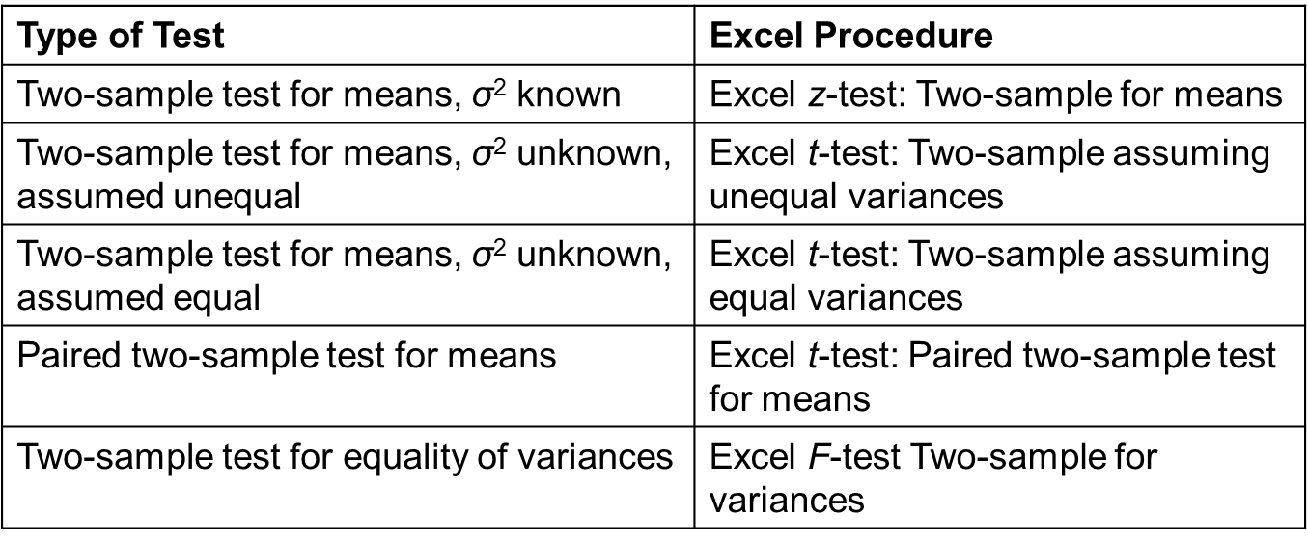
Excel Analysis Toolpak Procedures for Two-Sample Hypothesis Tests

Slide 34
Two-Sample Tests for Difference in Means
Forms of the hypothesis test:

Slide 35
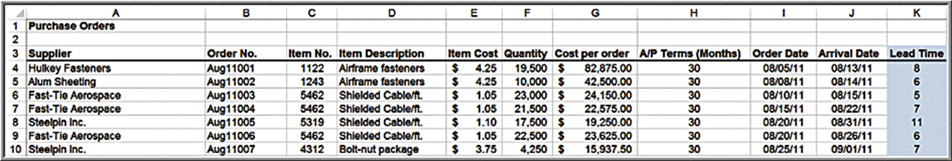
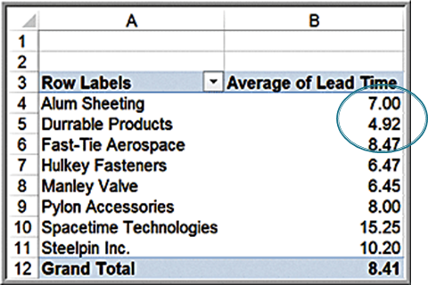
Example 7.9: Comparing Supplier Performance
Purchase Orders database
Determine if the mean lead time for Alum Sheeting
is greater than the mean lead time for Durrable Products

Slide 36
Selecting the Proper Excel Procedure
Population variances are known:
z-Test: Two-Sample for Means
Population variances are unknown and assumed unequal:
t-Test: Two-Sample Assuming Unequal Variances
Population variances are unknown but assumed equal:
t-Test: Two-Sample Assuming Equal Variances
These tools calculate the test statistic, the p-value for both a one-tail and two-tail test, and the critical values for one-tail and two-tail tests.

Slide 37
Interpreting Excel Output
If the test statistic is negative, the one-tailed p-value is the correct p-value for a lower-tail test; however, for an upper-tail test, you must subtract this number from 1.0 to get the correct p-value.
If the test statistic is nonnegative (positive or zero), then the p-value in the output is the correct p-value for an upper-tail test; but for a lower-tail test, you must subtract this number from 1.0 to get the correct p-value.
For a lower-tail test, you must change the sign of the one-tailed critical value.

Slide 38
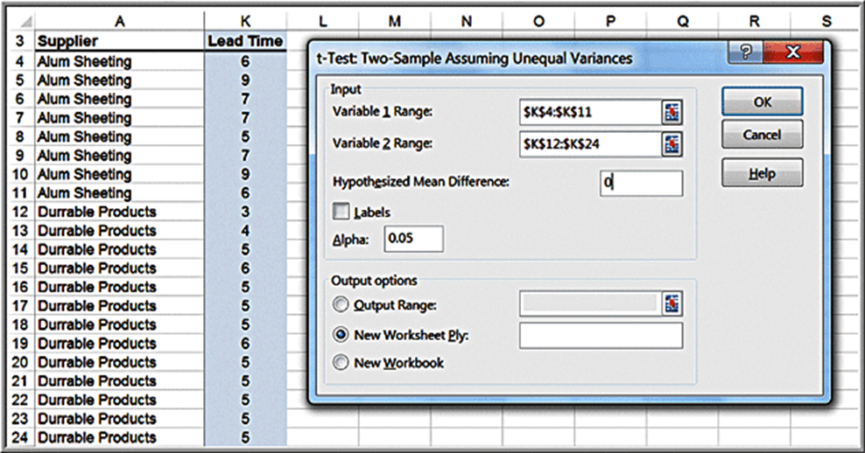
Example 7.10: Testing the Hypotheses for Supplier Lead-Time Performance (1 of 2)
t-Test: Two-Sample Assuming Unequal Variances
Variable 1 Range: Alum Sheeting data
Variable 2 Range: Durrable Products data

Slide 39
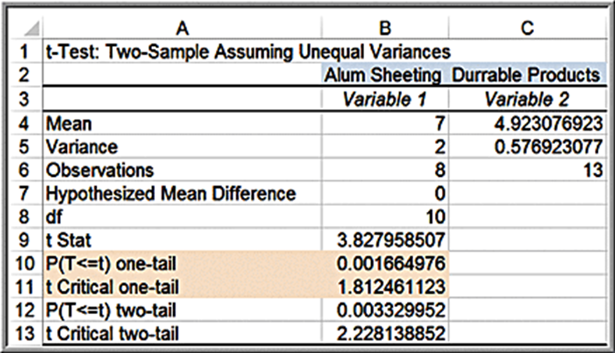
Example 7.10: Testing the Hypotheses for Supplier Lead-Time Performance (2 of 2)
Results
Rule 2: If the test statistic is nonnegative (positive or zero), then the p-value in the output is the correct p-value for an upper-tail test.
t = 3.83
Critical value = 1.81
p-value = 0.00166
Reject

Slide 40
Two-Sample Test for Means with Paired Samples
In many situations, data from two samples are naturally paired or matched.
When paired samples are used, a paired t-test is more accurate than assuming that the data come from independent populations.
Hypotheses (
is the mean difference between the paired
samples):
Excel Data Analysis tool: t-Test: Paired Two-Sample for Means

Slide 41
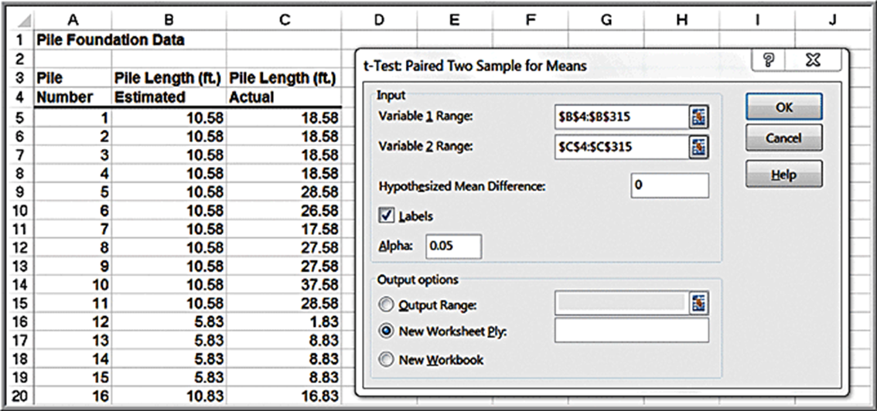
Example 7.11: Using the Paired Two-Sample Test for Means (1 of 2)
Excel file Pile Foundation
Test for a difference in the means of the estimated and actual pile lengths (two-tailed test).

Slide 42
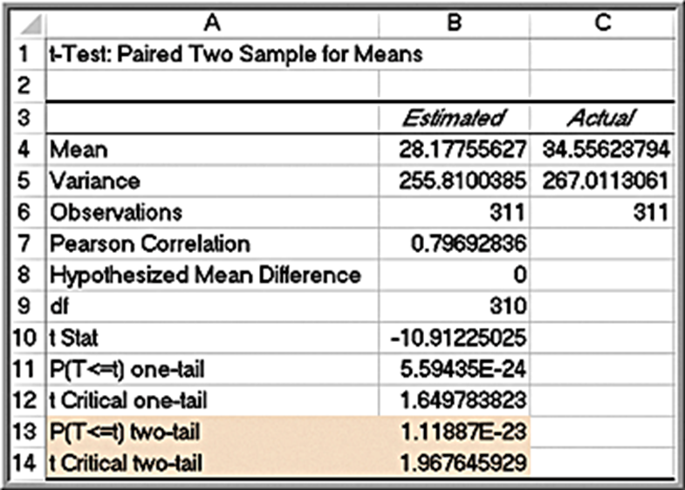
Example 7.11: Using the Paired Two-Sample Test for Means (2 of 2)
Results:
t = −10.91
t is smaller than the lower critical value
p-value
Reject the null hypothesis.

Slide 43
Two-Sample Test for Equality of Variances
Test for equality of variances between two samples using a new type of test, the F-test.
To use this test, we must assume that both samples are drawn from normal populations.
Hypotheses:
F-test statistic:
Excel tool: F-test for Equality of Variances

Slide 44
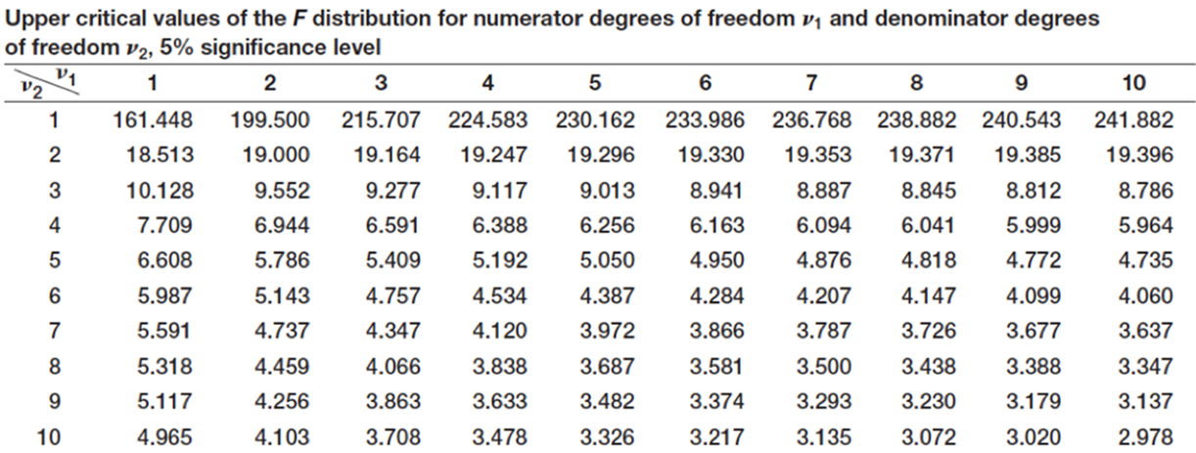
F-Distribution
The F-distribution has two degrees of freedom, one associated with
the numerator of the F-statistic,
and one associated with the
denominator of the F-statistic,
Table 4, Appendix A provides only upper-tail critical values, and the distribution is not symmetric.

Slide 45
Conducting the F-Test
Although the hypothesis test is really a two-tailed test, we will simplify it as an upper-tailed, one-tailed test to make it easy to use tables of the F-distribution and interpret the results of the Excel tool.
We do this by ensuring that when we compute F, we take the ratio of the larger sample variance to the smaller sample variance.
Find the critical value
of the F-distribution, and then we reject the
null hypothesis if the F-test statistic exceeds the critical value.
Note that we are using
to find the critical value, not α.
This is because we are using only the upper tail information on which to base our conclusion.

Slide 46
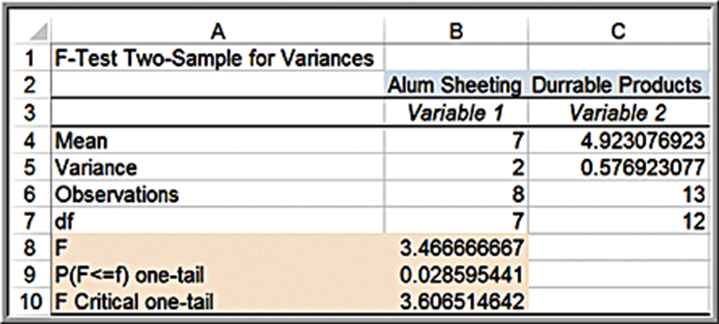
Example 7.12: Applying the F-Test for Equality of Variances
Determine whether the variance of lead times is the same for Alum Sheeting and Durrable Products in the Purchase Orders data.
The variance of the lead times for Alum Sheeting is larger than the variance for Durable Products, so this is assigned to Variable 1.
F = 3.47
Critical value = 3.607
P-value = 0.029
Reject

Slide 47
Analysis of Variance (A N O V A)
Used to compare the means of two or more population groups.
at least one mean is different from the others
A N O V A derives its name from the fact that we are analyzing variances in the data.
A N O V A measures variation between groups relative to variation within groups.
Each of the population groups is assumed to come from a normally distributed population.

Slide 48
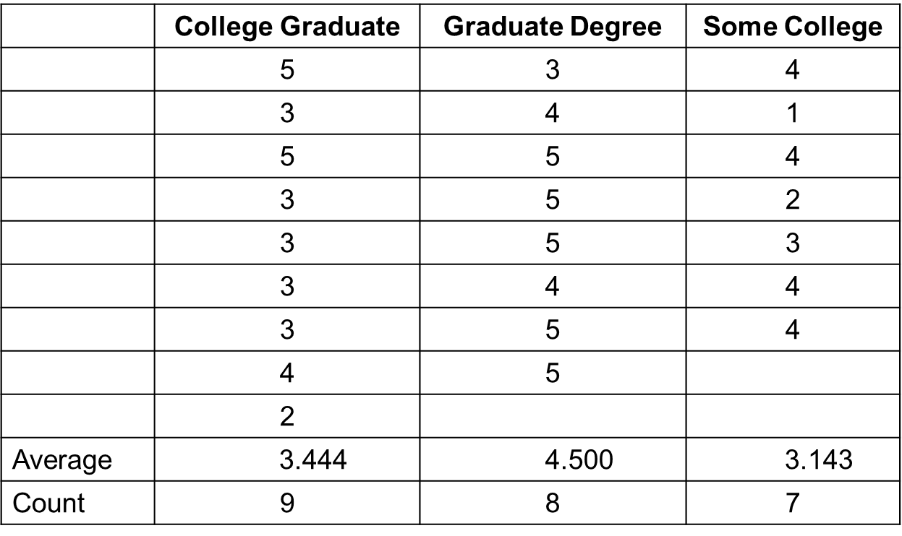
Example 7.13: Difference in Insurance Survey Data
Determine whether any significant differences exist in satisfaction among individuals with different levels of education.
The variable of interest is called a factor. In this example, the factor is the educational level, and we have three categorical levels of this factor, college graduate, graduate degree, and some college.

Slide 49
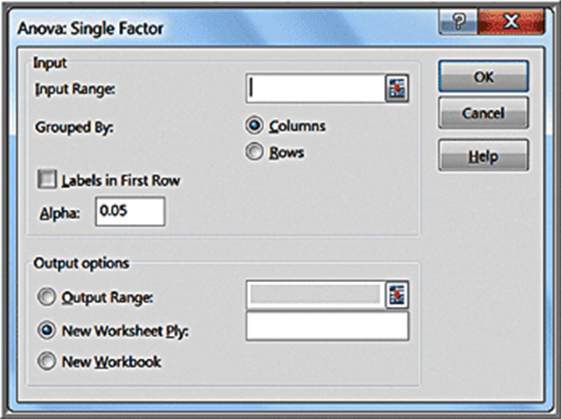
Example 7.14: Applying the Excel A N O V A Tool (1 of 2)
Data Analysis tool: A N O V A: Single Factor
The input range of the data must be in contiguous columns

Slide 50
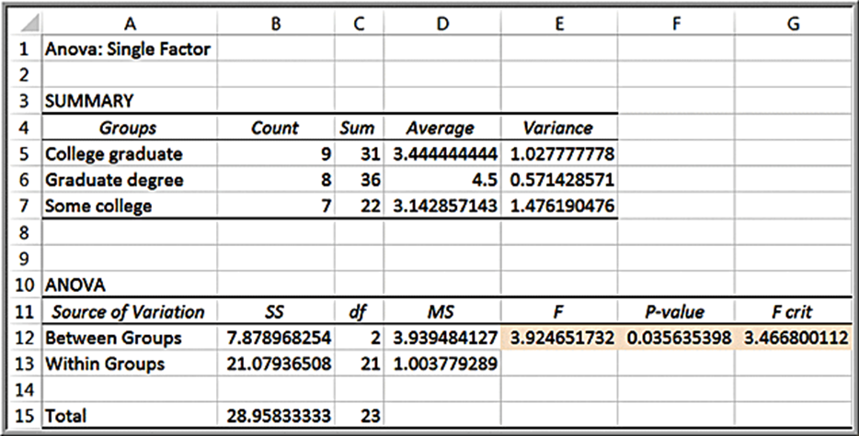
Example 7.14: Applying the Excel A N O V A Tool (2 of 2)
Results
F = 3.92
p-value = 0.0356
Reject

Slide 51
Assumptions of A N O V A
The m groups or factor levels being studied represent populations whose outcome measures
are randomly and independently obtained,
are normally distributed, and
have equal variances.
If these assumptions are violated, then the level of significance and the power of the test can be affected.

Slide 52
Chi-Square Test for Independence
Test for independence of two categorical variables.
two categorical variables are independent
two categorical variables are dependent

Slide 53
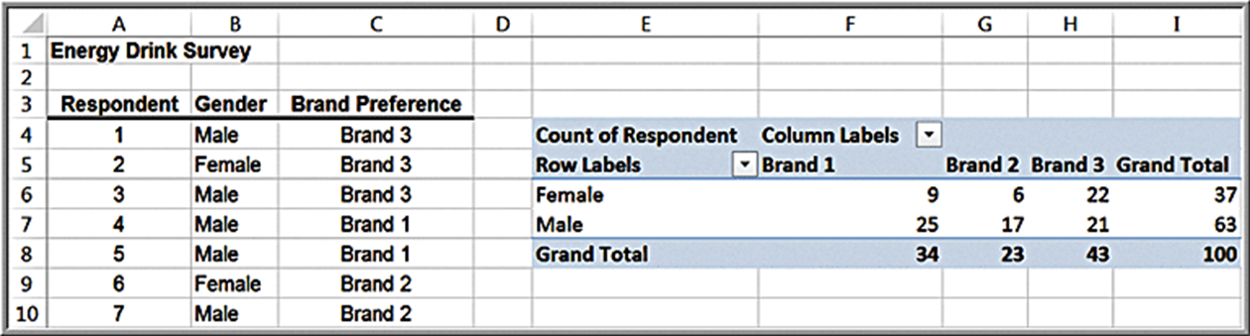
Example 7.15: Independence and Marketing Strategy
Energy Drink Survey data. A key marketing question is whether the proportion of males who prefer a particular brand is no different from the proportion of females.
If gender and brand preference are indeed independent, we would expect that about the same proportion of the sample of female students would also prefer brand 1.
If they are not independent, then advertising should be targeted differently to males and females, whereas if they are independent, it would not matter.

Slide 54
Chi-Square Test Calculations (1 of 3)
Step 1: Using a cross-tabulation of the data, compute the expected frequency if the two variables are independent.

Slide 55
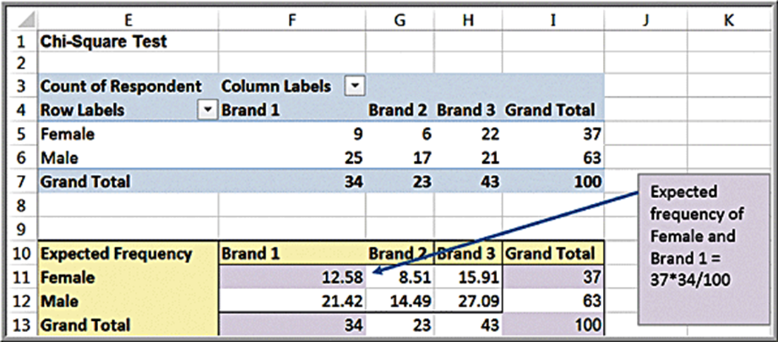
Example 7.16: Computing Expected Frequencies

Slide 56
Chi-Square Test Calculations (2 of 3)
Step 2: Compute a test statistic, called a chi-square
statistic, which is the sum of the squares of the differences
between observed frequency,
and expected frequency,
divided by the expected frequency in each cell:

Slide 57
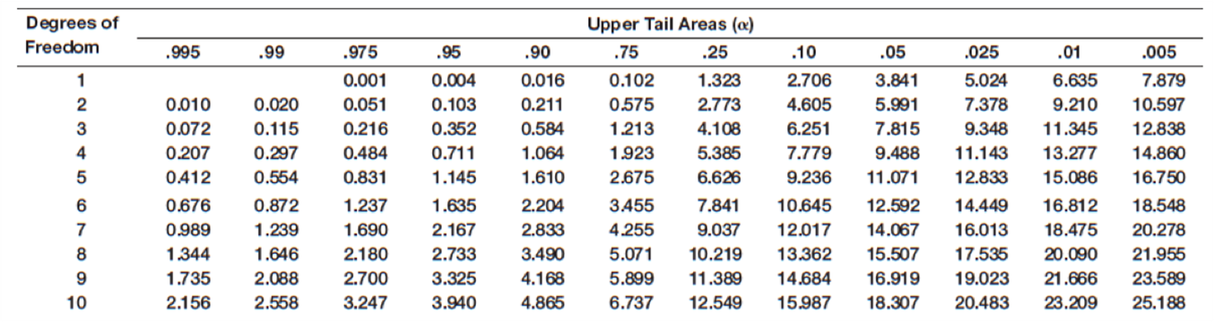
Chi-Square Distribution
The sampling distribution of
is a special distribution
called the chi-square distribution.
The chi-square distribution is characterized by degrees of freedom.
Table 3 in Appendix A

Slide 58
Chi-Square Test Calculations (3 of 3)
Step 3: Compare the chi-square statistic for the level of significance α
to the critical value from a chi-square distribution with
degrees of freedom, where r and c are the number of rows and
columns in the cross-tabulation table, respectively.
The Excel function
returns
the value of
that has a right-tail area equal to probability for a
specified degree of freedom.
By setting probability equal to the level of significance, we can obtain the critical value for the hypothesis test.
The Excel function
computes the p-value for the chi-square test.

Slide 59
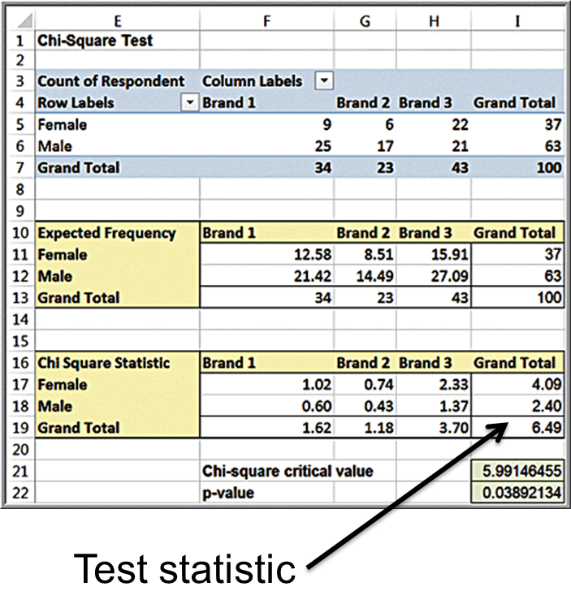
Example 7.17: Conducting the Chi-Square Test
Test statistic = 6.49
Critical value =
p-value =
Reject

Slide 60
Cautions in Using the Chi-Square Test
The chi-square test assumes adequate expected cell frequencies.
A rule of thumb is that there be no more than 20% of cells with expected frequencies smaller than 5, and no expected frequencies of zero.
Consider aggregating some of the rows or columns in a logical fashion to enforce this assumption.

Slide 61
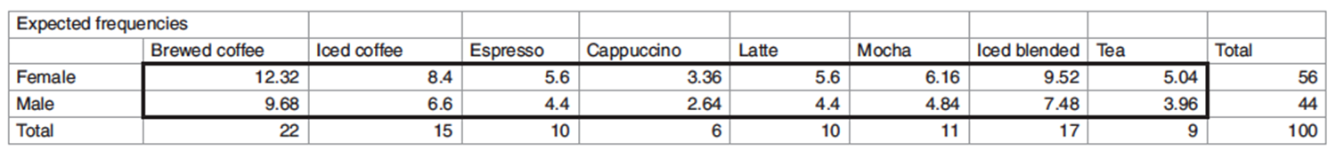
Example 7.18: Violations of Chi-Square Assumptions (1 of 2)
A survey of 100 students at a university queried their beverage preferences at a local coffee shop.
Of the 16 cells, five, or over 30%, have frequencies smaller than 5. Four of them are in the Cappuccino, Latte, and Mocha columns; these can be aggregated into one column called Hot Specialty beverages.

Slide 62
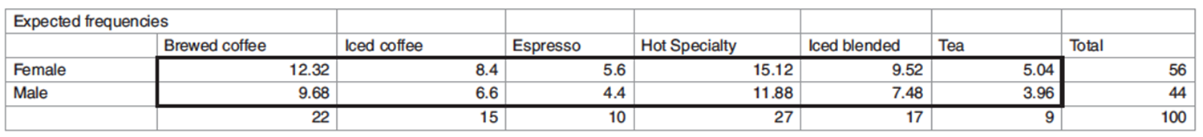
Example 7.18: Violations of Chi-Square Assumptions (2 of 2)
Now only 2 of 12 cells have an expected frequency less than 5; this now meets the assumptions of the chi-square test.

